Slide 1
Python programming
unit 2 - string

Slide 2
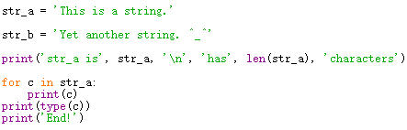
string
String is a collection of letters. Three ways to give a string value: single quote, double quote, triple quote.
it can be used in for loop statement
c is string type, the value of c only contains one single letter

Slide 3
string
Special characters in string, we can use ‘\’. This is called escape
Code | Result
\' | Single Quote
\\ | Backslash
\n | New Line
\r | Carriage Return
\t | Tab
\b | Backspace
\f | Form Feed
\ooo | Octal value
\xhh | Hex value

Slide 4
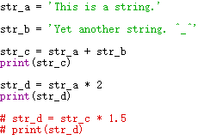
string
String used with math operators (+ and *)

Slide 5



In class practice: what is the result for those code?

Slide 6
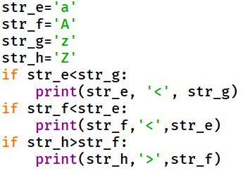
string
String comparison
The comparison will be based on which comes first in dictionary. (Alphabetic order)
Upper case capital letter comes before lower case.
The word who comes first is smaller.

Slide 7
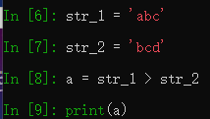

In class practice: what is the result for those code?

Slide 8
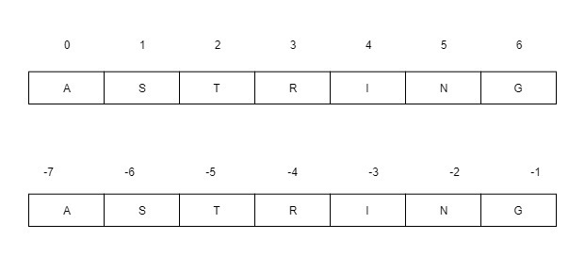
string
String index

Slide 9

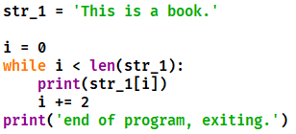
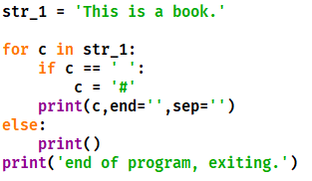
In class practice: what is the result for those code?

Slide 10
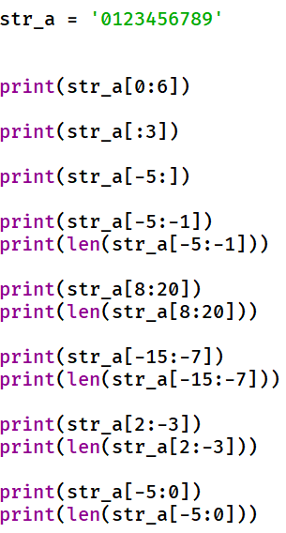
string
String slicing
This results in an empty string

Slide 11

In class practice: what is the result for those code?

Slide 12
unpacking
str data in python can use with unpack

Slide 13


In class practice: what is the result for those code?

Slide 14
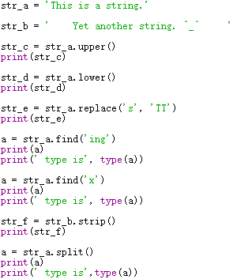
String methods
change string content with build in functions
capitalize(), upper(), lower(), strip(), replace(),split()
Those function keep the original string unchanged, return a modified string (or another type, like list)
Other string manipulating function like find(), expandtabs(), format() etc.
String is immutable. Change string will not affect the original string value, it will be kept as it is, and will return a new one with the changed content

Slide 15
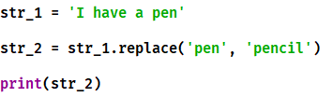



In class practice: what is the result for those code?

Slide 16
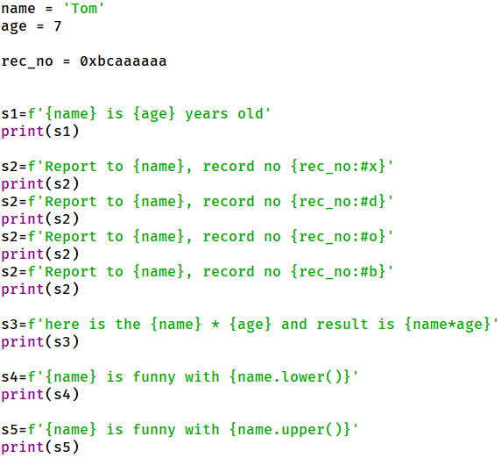
F string
a way of format information, mainly can be used for output.
Thins inside curly bracket are expressions to be evaluated.

Slide 17

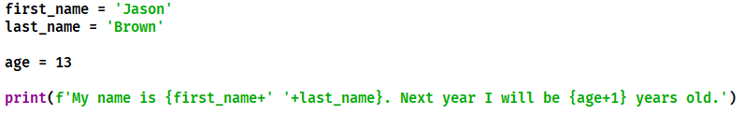
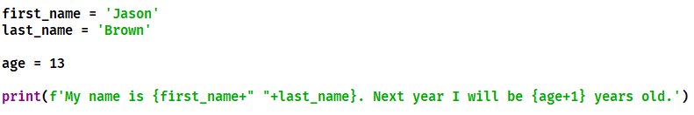
In class practice: what is the result for those code?

Slide 18
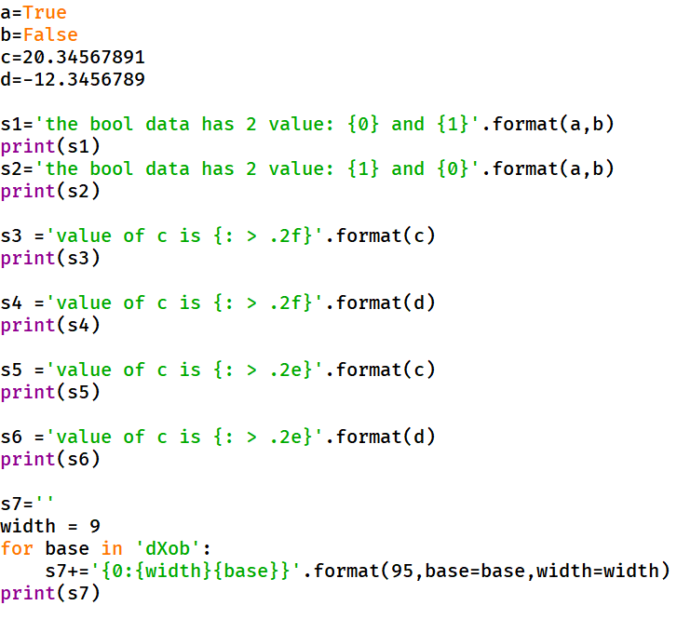
String format()
Things outside of curly bracket are copied and unchanged.
Things inside curly braces are considered “replacement fields”. Will be replace by arguments of format function.
Two ways: positional, or name/keyword

Slide 19
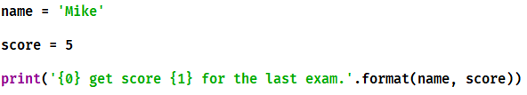
In class practice: what is the result for those code?

Slide 20
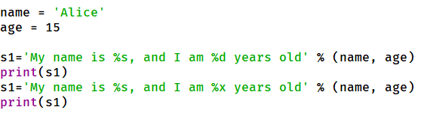
%-string operator
Left side of % operator is the format. Inside the format % is for replacement place.
Right side of % operator is information to be inserted. Use tuple if more than one.
Match with position.

Slide 21
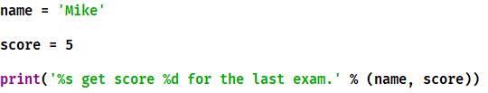
In class practice: what is the result for those code?

Slide 22
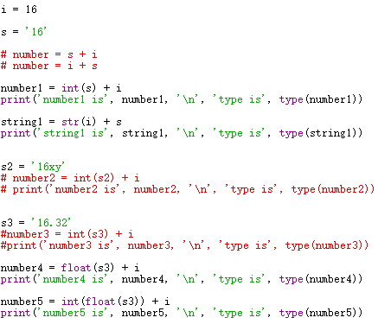
explicit conversion between string and number
difference of string and number
string and number, even they are expressing same thing (numbers), they are different
add string to number will give error by Python

Slide 23



In class practice: what is the result for those code?

Slide 24
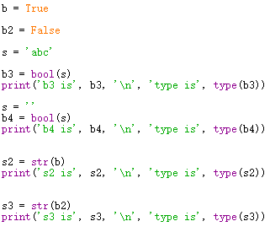
explicit conversion between string and bool
bool()
Empty string will be converted to False
non empty string will be converted to True
str()
bool value of True will be converted to string format ‘True’. they are not same
bool value of False will be converted to string format of ‘False’. they are not same

Slide 25

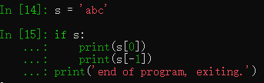
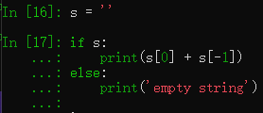
In class practice: what is the result for those code?

